Slide 1

NBA Synergy Play-type Analysis
Group 3:
Ishan Mehta
Jinwei Zhu
Justin Chen
Kedi Xia
Mingyuan Zhang

Slide 2
Motivation
Over the years the traditional 5 team roles have started to blur and change due to the advent of 3-pt shooting and analytics.
Players score in a higher variety of ways now and being able to manufacture the most efficient source of buckets is of great importance.
Need a new evaluation of types of players to determine better and more balanced team compostions.

Slide 3
Methodology
Analyze each player based on their components of different play types.
Use PCA to project the players into 3D for visualization
Use K means method to determine the best way of categorizing the new types of players.

Slide 4
Flow chart of our process
Get Data using API
Clean the Data
(Based on Game Plays…)
Choose the data to put into the PCA
Find five players closest to each cluster centers
Using k-means to cluster the results
11 Dimensions to 3-D
Reconstruction to higher dimensions
Comparing the possesion components
Naming the new types of group strategies based on clustering

Slide 5
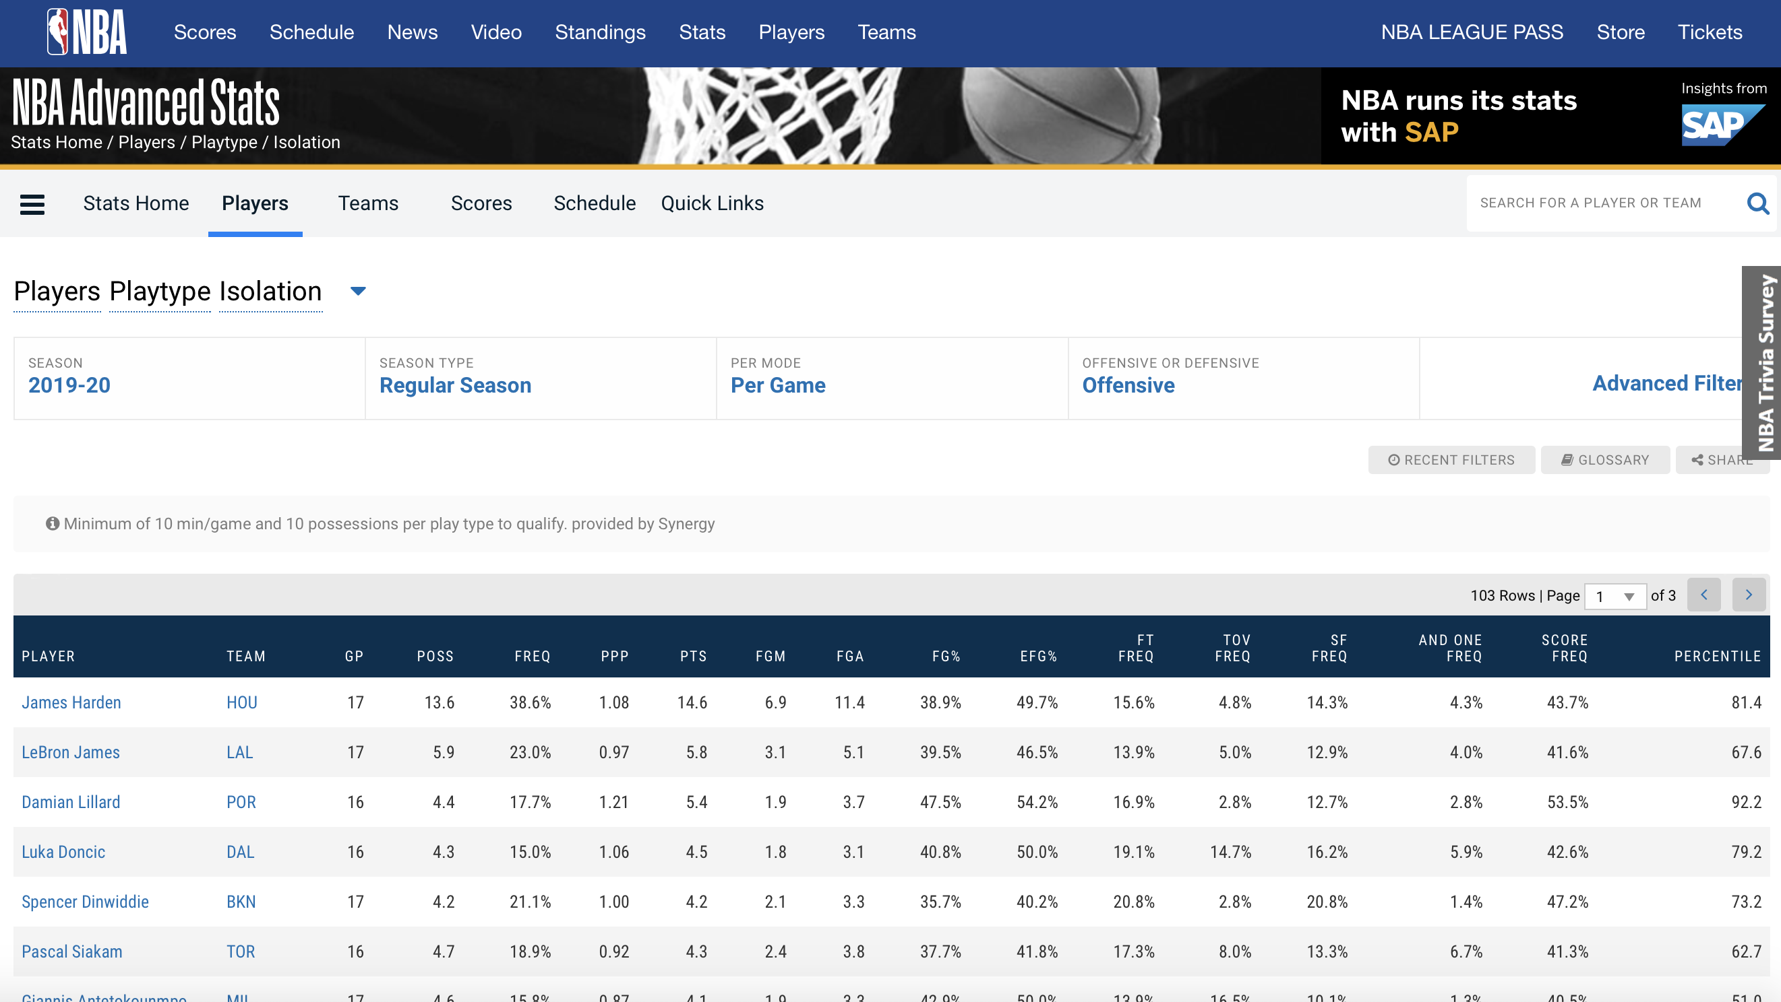
Dataset
We scrape down the data from https://stats.nba.com
Yearly game play data for all individual players in different play types

Slide 6
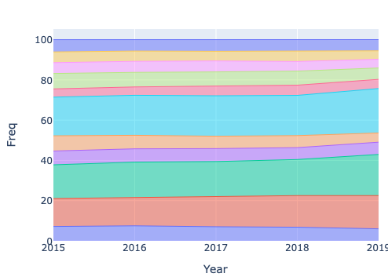
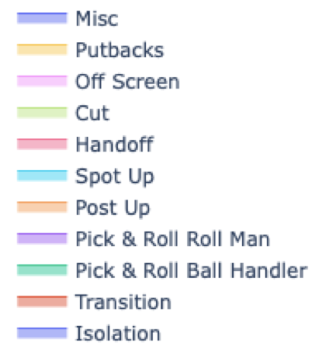
How play types change during the past 5 years?
https://plot.ly/~swishan/20

Slide 7
What’s the most efficient play type? ---Points per possession

Slide 8
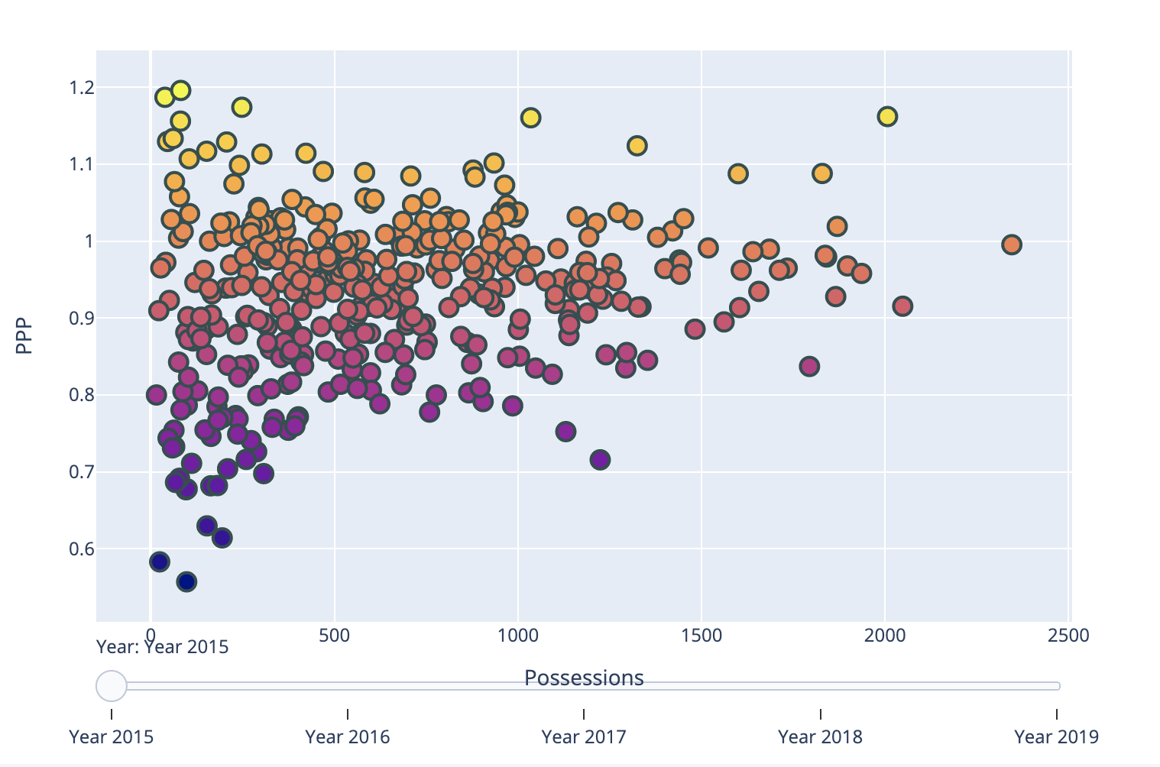
PPP vs Total Possessions player scatter
https://plot.ly/~swishan/18

Slide 9
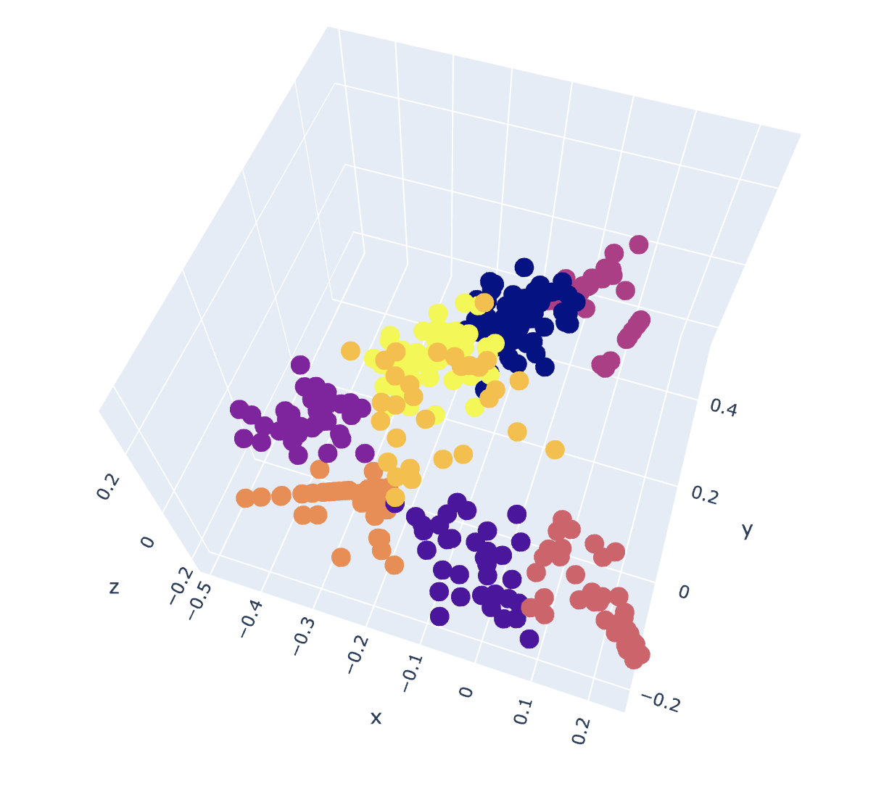
How many roles should a team have?
https://plot.ly/~swishan/16

Slide 10
How would typical players behave?

Slide 11
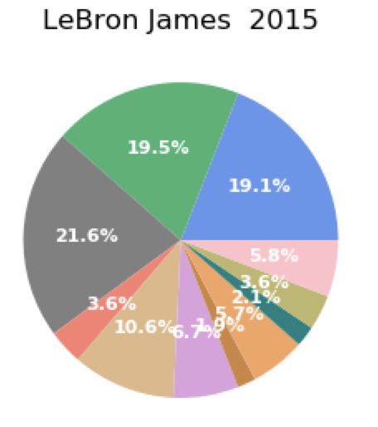
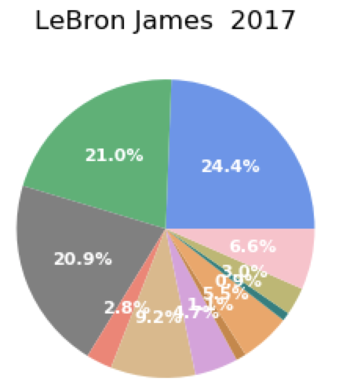
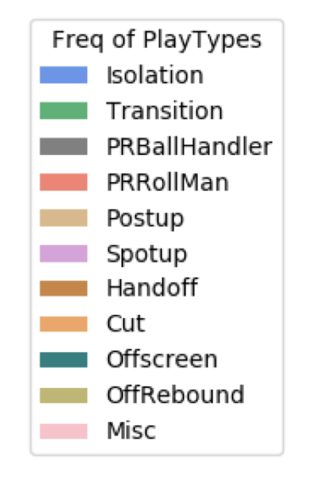
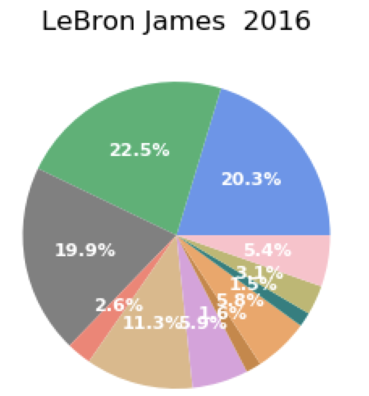

LeBron James

Slide 12
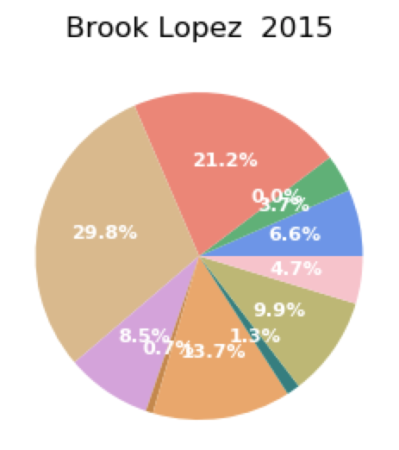
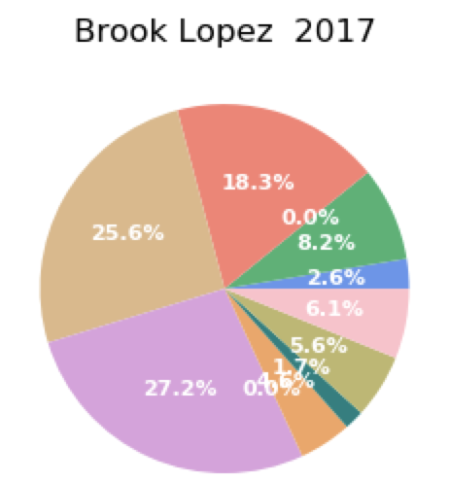
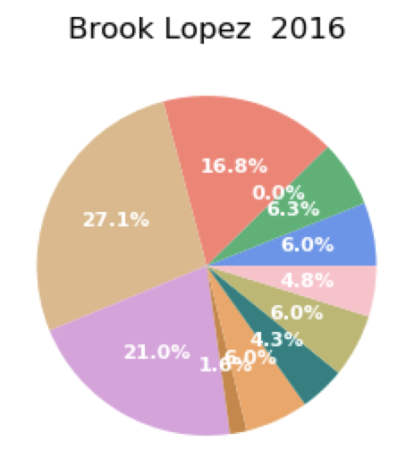
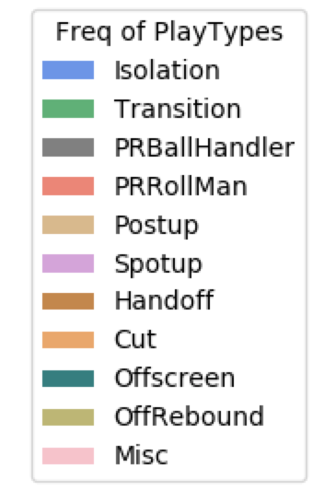
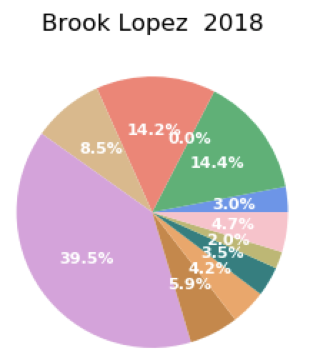
Brook Lopez

Slide 13
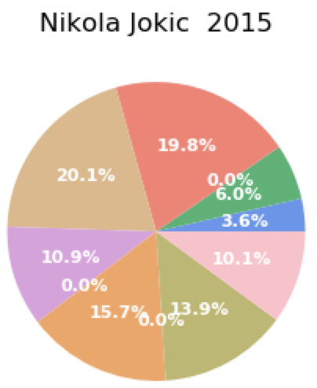
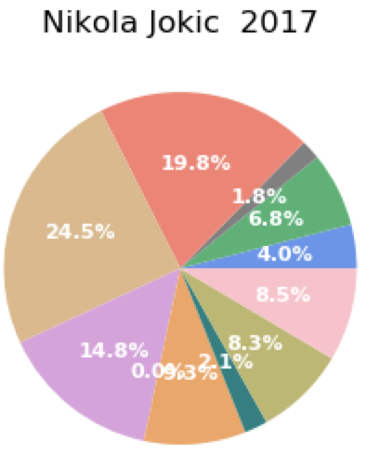
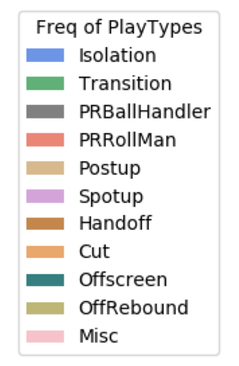
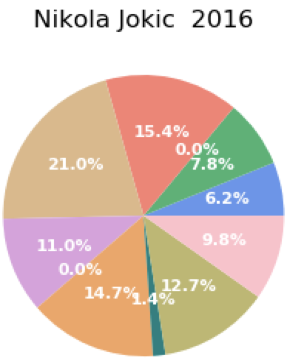
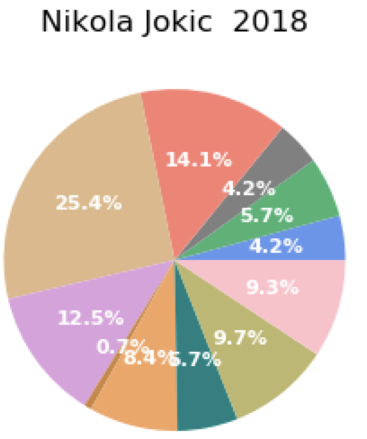
Nikola Jokic

Slide 14

Conclusions
Player roles have broken a lot of pre-conceived notions in the last 5 years.
A tool that allows teams to clearly identify player role paradigms would be very useful for teams in terms of deciding strategy.
The most efficient shots are the hardest ones to create.

Slide 15
Thanks for listening!

